Slide 1
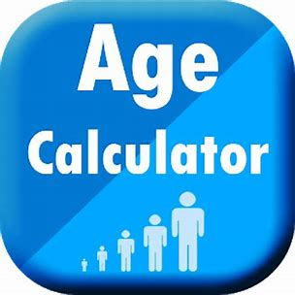
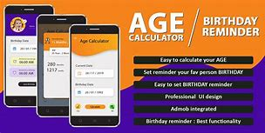
Developed by :
M. Sai Akash
192110237

Slide 2
Outline
Aim objects
Abstract
Introduction
Existing work
Proposed work
Data flow diagram
Software and hard ware / requirements
Module description
Screen shot
Conclusion
Feature enhancement
references

Slide 3
AIM:
To find the age of the person by using age calculator
It will simplifies the effort and saves the time..
It Is easy to use and get the age of the person

Slide 4
Abstract:
Age calculator android project as the name indicate is used to calculate any persons present age and make analysis for future reference.
To start using this android project, you need to fill the information of persons as contact list and get required information in just one click.

Slide 5
Introduction :
The age of a person can be counted differently in different cultures.
This calculator is based on the most common age system. In this system, age grows at the birthday.
For example, the age of a person that has lived for 3 years and 11 months is 3 and the age will turn to 4 at his/her next birthday one month later.

Slide 6
Age Calculator is an application developed for the purpose of calculating exact age of user.
The application woks on any devices fulfilling the basic requirement of application.
It mainly focuses at determination of exact age of user depending upon the input date of birth.

Slide 7
Existing work:
Even though the existing system allows you to calculate the present age of any persons.
This such application doesn’t allows you to make future analysis and gain other important information’s.
Apart from these, there was no facility of saving their data permanently and make modification whenever required.

Slide 8
Proposed work
In the proposed work we introduced some features
1}– Birthday reminder
2}– Predefined calendar
3}–Easy interface

Slide 9
steps
It will be like this : - user enters the date-of-birth - the age is automatically calculated till today. Age format must be xx-years, xx -months, xx-days

Slide 10
Data flow diagram
Age calculator
Present date
Date of birth
calculate
R E S U L T

Slide 11
Software requirments
Hardware requirments
Android studio version 3.3 latest
Internet connection
Java script
xml
Laptop
windows
ios

Slide 12
Module description
This new age calculator android project will not only able to save local data to your android phone, but it will also able to import the contact information’s of all your friends from various social networking sites.
Thus it eliminated the need of entering data, if you have the power of internet.
Again this app will also able to work online and in offline mode. This app will provide the current age of requested contact, their next birthday and much more analysis with one click only.

Slide 13
There are four keys provided with every contact by which you can manage their data easily.
To make your complex task easier, the provided information format will also be available and by default, it will provide the age and analysis report in terms of days, hours, minutes, seconds combinations.

Slide 14
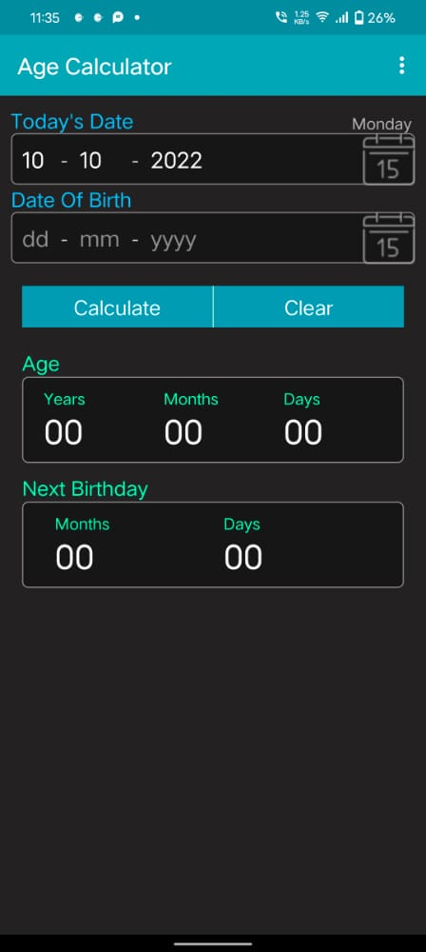
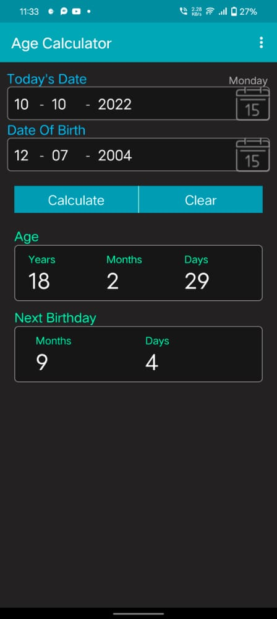
Screen shots

Slide 15
Conclusion
From this project we have the conclude that we can calculate the age of the person by android
It will be consume the less time and effort
It can display next birthday

Slide 16
Features of this project:
This system will automatically integrate with server date and time or your local system time and information will be provided in the format of years, months, hours, days, and minutes and in seconds.
You can add important events date for your particular friends by knowing their birthdays.
To make your friends recognizable, you can add their profile pictures and other contact information’s.

Slide 17
References
Google
Youtube
Browser

Slide 18
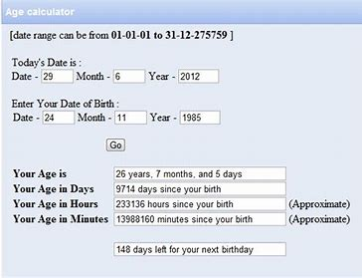

Slide 19
Thank you

